Slide 1
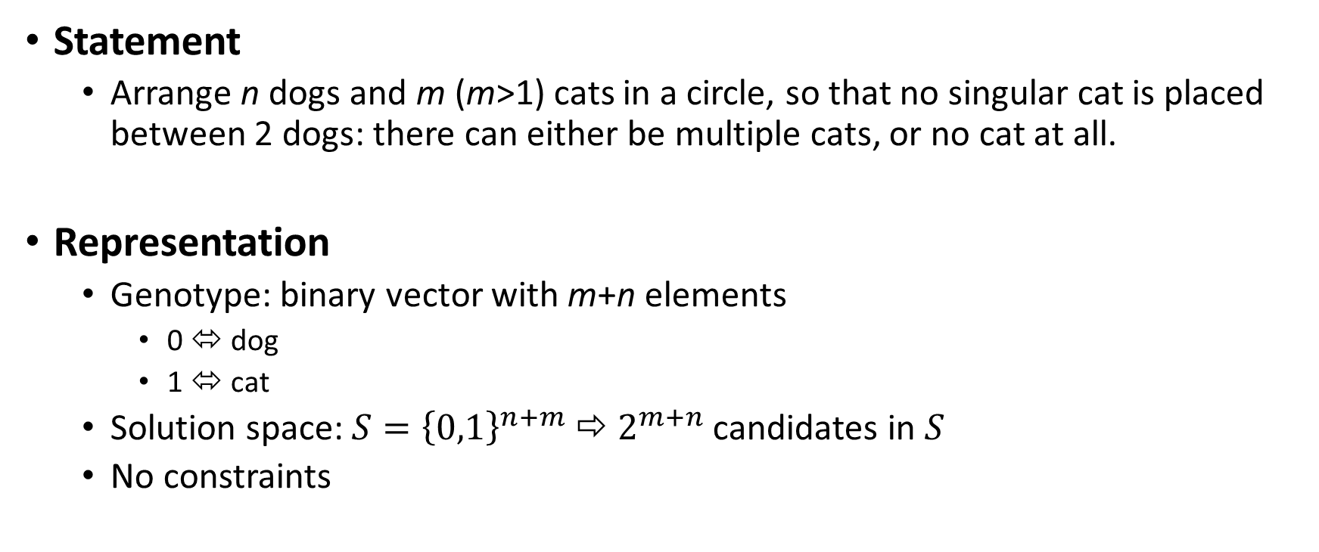
Arrange dogs and cats
Statement
Arrange n dogs and m (m>1) cats in a circle, so that no singular cat is placed between 2 dogs: there can either be multiple cats, or no cat at all.
Representation
Genotype: binary vector with m+n elements
0 ⬄ dog
1 ⬄ cat
Solution space: ${S=\left\{0,1\right\}}^{n+m}$ ⇨ $2^{m+n}$ candidates in $S$
No constraints

Slide 2
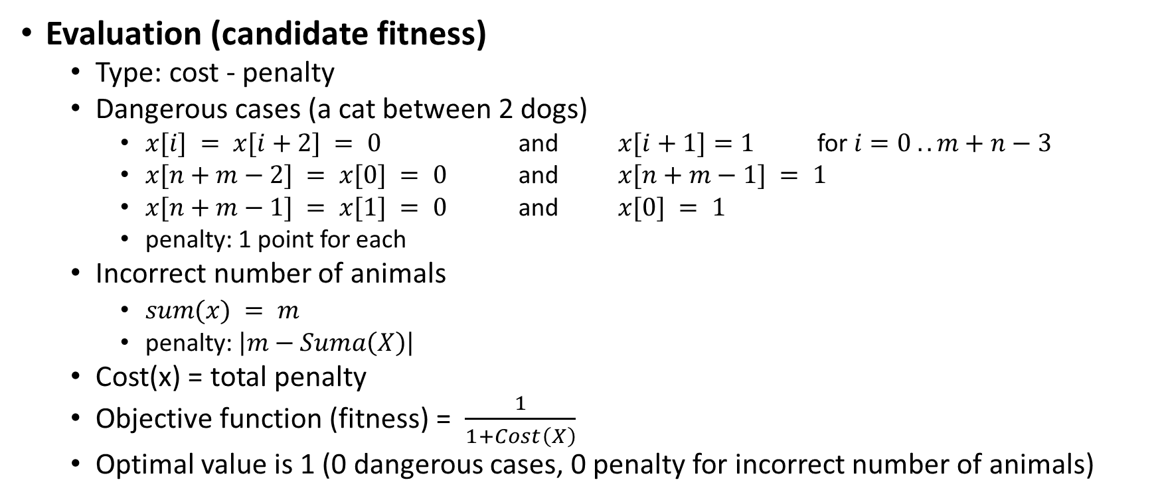
Arrange dogs and cats
Evaluation (candidate fitness)
Type: cost - penalty
Dangerous cases (a cat between 2 dogs)
$x[i] = x[i+2] = 0$ and $x[i+1]=1$ for $i=0 .. m+n−3$
$x[n+m−2] = x[0] = 0$ and $x[n+m−1] = 1$
$x[n+m−1] = x[1] = 0$ and $x[0] = 1$
penalty: 1 point for each
Incorrect number of animals
$sum(x) = m$
penalty: $\left|m−Suma\left(X\right)\right|$
Cost(x) = total penalty
Objective function (fitness) = $\frac{1}{1+Cost\left(X\right)}$
Optimal value is 1 (0 dangerous cases, 0 penalty for incorrect number of animals)

Slide 3
Arrange dogs and cats
Population model
Generational. Easy to evaluate fitness function. Constant size population dim
Stop condition
Maximum number of permitted generations
Minimum diversity: at least 2 distinct fitness values
Reaching the optimal value of the fitness function

Slide 4
Arrange dogs and cats
Parent selection
SUS, with FPS with sigma scaling
Crossover
General crossover scheme without constraints, includes asexual crossover.
Crossover operator: discreet: single-point / multi-point / uniform
Crossover probability: 0.7
Number of descendants: dim

Slide 5
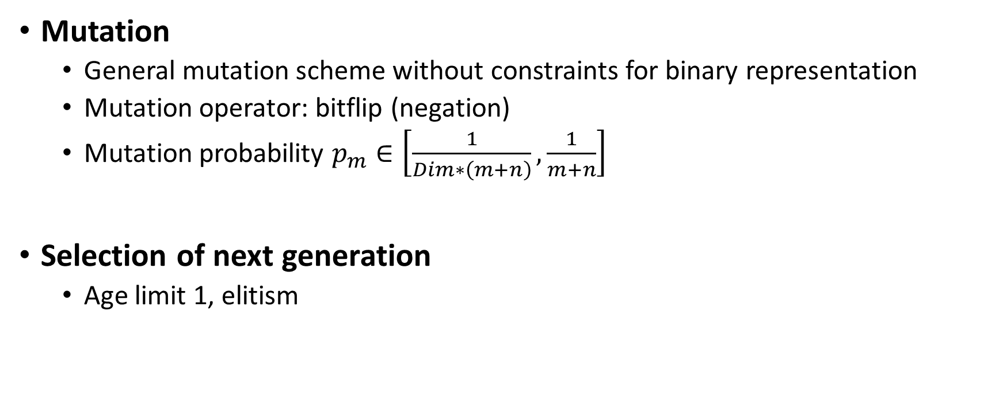
Arrange dogs and cats
Mutation
General mutation scheme without constraints for binary representation
Mutation operator: bitflip (negation)
Mutation probability $p_{m}∈\left[\frac{1}{Dim∗\left(m+n\right)},\frac{1}{m+n}\right]$
Selection of next generation
Age limit 1, elitism

Slide 6
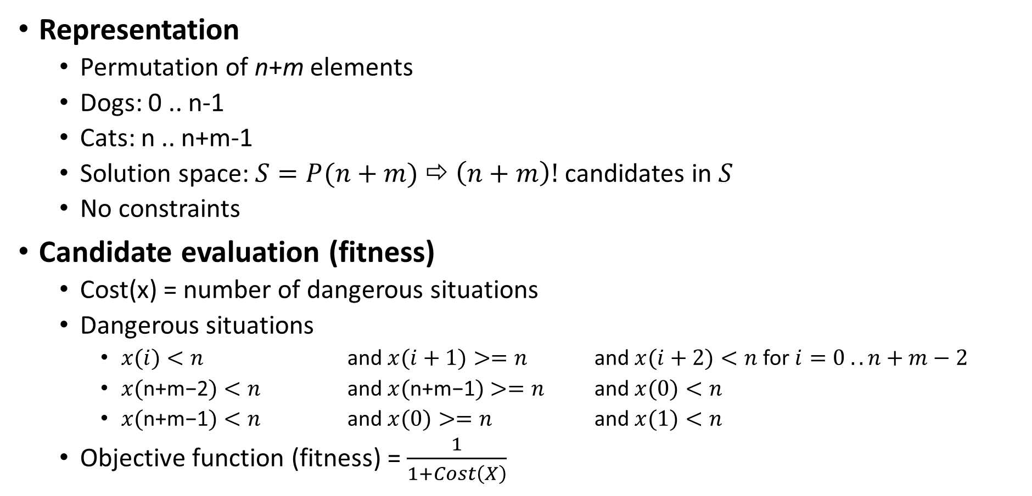
Arrange dogs and cats – another approach
Representation
Permutation of n+m elements
Dogs: 0 .. n-1
Cats: n .. n+m-1
Solution space: $S=P(n+m)$ ⇨ $\left(n+m\right)!$ candidates in $S$
No constraints
Candidate evaluation (fitness)
Cost(x) = number of dangerous situations
Dangerous situations
$x(i)<n$ and $x(i+1)>=n$ and $x(i+2)<n$for $i=0 .. n+m−2$
$x(\text{n}\text{+}\text{m}\text{−2})<n$ and $x(\text{n}\text{+}\text{m}\text{−1})>=n$ and $x(0)<n$
$x(\text{n}\text{+}\text{m}\text{−1})<n$ and $x(0)>=n$ and $x(1)<n$
Objective function (fitness) = $\frac{1}{1+Cost\left(X\right)}$

Slide 7
Arrange dogs and cats
Work
1. design a genetic algorithm to solve the problem using the alternate approach
2. implement the genetic algorithm for both approaches

